Slide 1
Team 2
Group Names:
Liz Stell
Yu Sheng Lu
Michael Chilton Zuber
Thomas Szot
The Business Opening Dilemma Solved Using YELP Business and Review Data

Slide 2
Establishing a new business in Portland OR
Business Questions:
Where in Portland Oregon is the best spot to open our new business?
What kind of business should we open?
Based on reviews, what is something unique that we can do?
What are some important pieces of information we can gather from the reviews? From this information, how can we apply it to our new business?

Slide 3
YELP Business & Review Data
Business Data:
We used this data to create a map that helped us decide about where to open our new business.
Some of the fields included a unique business ID, business name and address, total number of reviews, and average rating for a business.
We found a place in Portland with a high density of high YELP ratings
Review Data:
This data helped in our decision making of what type of business to open and what special things to incorporate into our business.
We cleaned up the data and set the city equal to Portland, Oregon. Then we used the merge function to merge with the yelp review by Business ID. This helped us get the businesses that are in the Portland, OR.

Slide 4
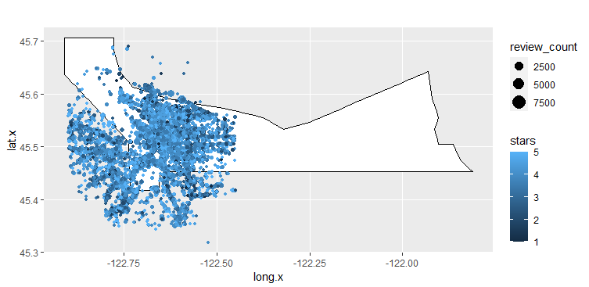

Slide 5
Where are we starting our business based on the map?
Based on the data from YELP, we have seen that the best reviews happen in the Alberta Park area of Portland OR.
We can see this because the light blue shading is visibly the best in that area on this map.
Based on the data, this seems to be the best area to open a business in. Good reviews mean other good business and heavy foot traffic to attract customers for a new business.

Slide 6
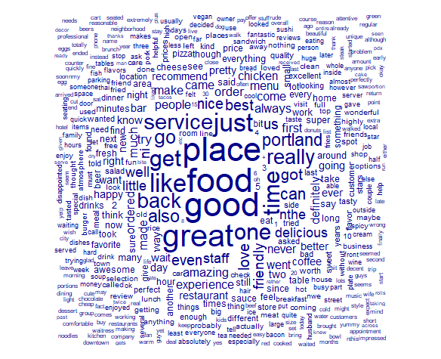
What are we opening based on the feedback that was most received?
Based on the word “FOOD” we have decided to open a restaurant.
Based on the words “SERVICE”, “EXPERIENCE”, “FRIENDLY” we know that we must hire the best staff for our patrons. The better the staff, the better the reviews.
Based on the words “CHICKEN”, “CHEESE”, “EGG”, “BURGER”, “COFFEE” we are going to open a breakfast/brunch restaurant.

Slide 7
From the YELP reviews what should we make sure we do for good reviews and what should we make sure we don’t do?
Based on what good words were used the most, it looks like we should stick to opening a restaurant. Based on the words “DELICIOUS”. It was used almost 84k times, clearly good food translates to good reviews.
Based on what bad words were used the most, good service will keep our good reviews up. We can see that because of the word “RUDE”. We must hire the best staff to keep up positive reviews.
GOOD
Feature | Frequency | Rank
good | 263,564 | 1
great | 239,200 | 2
like | 188,741 | 3
best | 98,753 | 4
nice | 96,602 | 5
love | 95,124 | 6
well | 91,279 | 7
friendly | 87,596 | 8
delicious | 83,179 | 9
amazing | 75,982 | 10
BAD
Feature | Frequency | Rank
bad | 39,269 | 1
fried | 30,772 | 2
hard | 23,958 | 3
disappointed | 20,364 | 4
wrong | 16,808 | 5
cold | 16,495 | 6
cheap | 14,868 | 7
problem | 14,286 | 8
rude | 12,811 | 9
expensive | 12,784 | 10

Slide 8
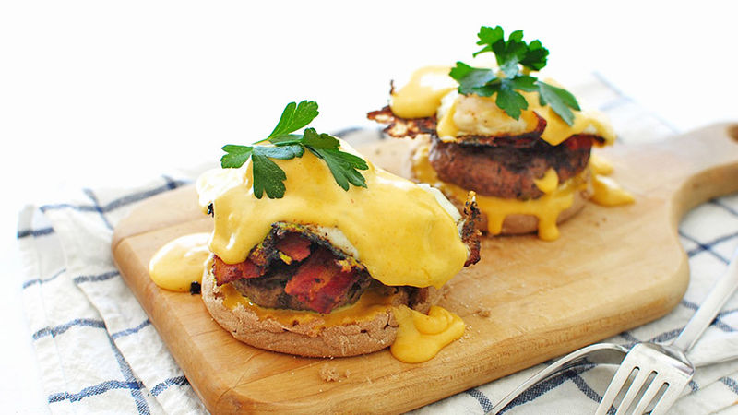
Cheesy Egg Benedict Burger

